Slide 1



Financial Results FY2021

Slide 2

FY 2021 – FINANCIAL SUMMARY
Detail
Detail

Slide 3
FY2021 – SALES VOLUME
Back
Industry Analysis
Segmented Sales Volume

Slide 4
FY2021 – SEGMENTED SALES VOLUME
Back

Slide 5
FY2021 – INDUSTRY ANALYSIS
Back

Slide 6



FY2021 NET SALES
Back
Sales Variance Analysis – AMD
Sales Variance Analysis – MCD
Sales Variance Analysis – Total

Slide 7
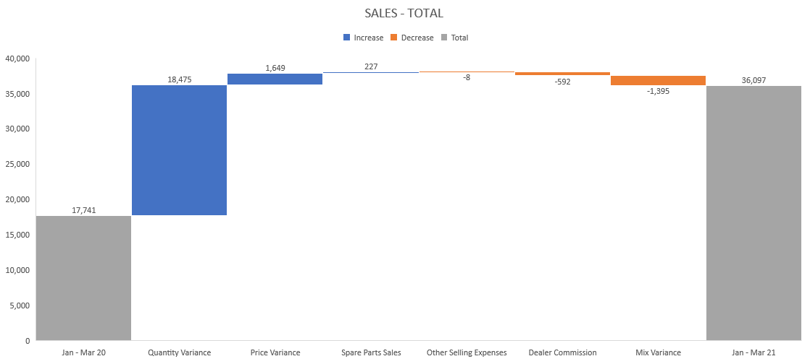
FY2021 – TOTAL SALES
Back

Slide 8
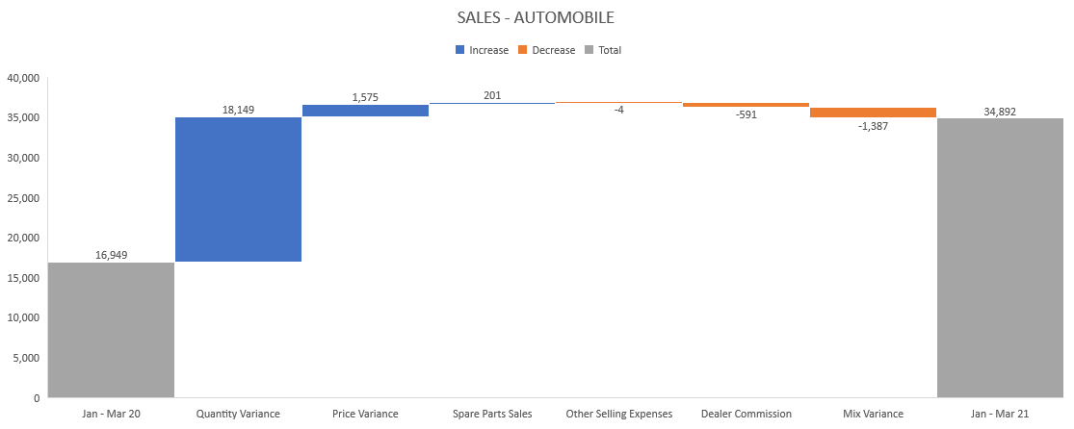
FY2021 – AUTOMOBILE SALES
Back

Slide 9
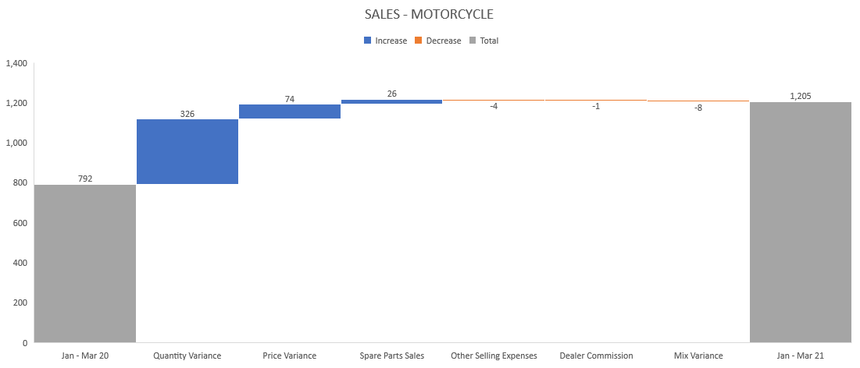
FY2021 – MOTORCYCLE SALES
Back

